Slide 1
LEQ: How are details in an informational text related?
Sub LEQ: How are scientific details in a text connected?

Slide 2
Cause Effect
How or why it happens.
What happens because of the cause.
I try my best at school,
so I get good grades.

Slide 3
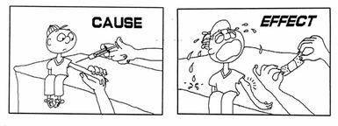
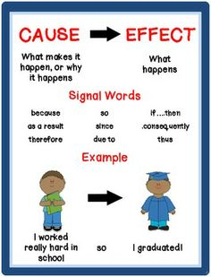
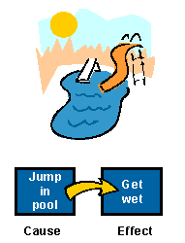
Cause Effect

Slide 4
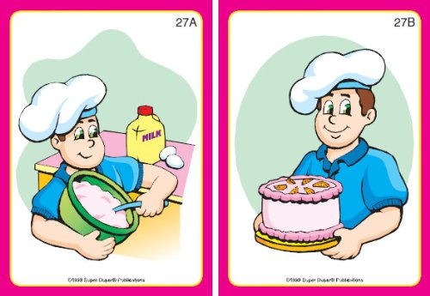
Which one is the cause? Which one is the effect?
Cause
Effect

Slide 5
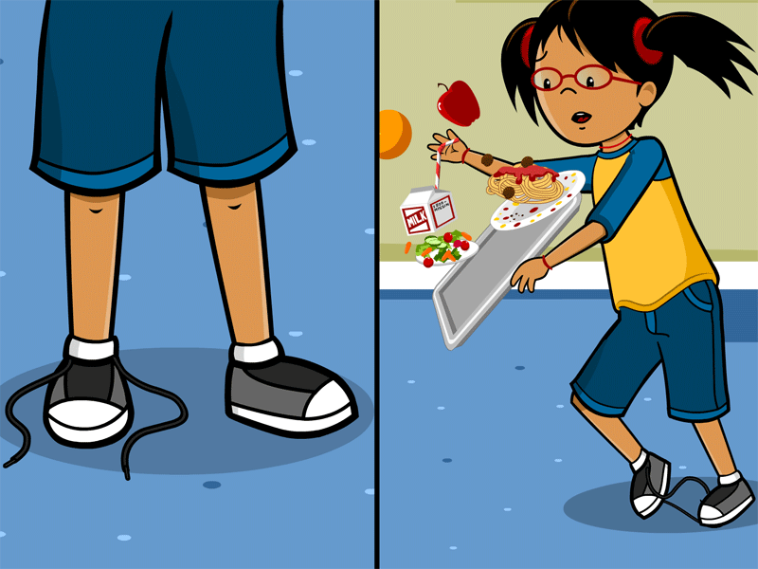
Which one is the cause? Which one is the effect?
Cause
Effect

Slide 6
What is the cause? What is the effect?
1. One day Matt woke up late, so he was late to school.
Cause- Matt woke up late.
Effect- Matt was late to school.
2. Claudia wanted to go outside and play with her friends. Her mom said she had to take out the trash before she could go play. Claudia did not take out the trash like she was told. When Claudia came home after playing outside she got in trouble.
Cause- Claudia did not take out the trash.
Effect- Claudia got in trouble.

Slide 7
Turn to a partner and talk.
What is cause?
What is effect?
Which comes first effect or cause?

Slide 8
Fact Opinion
A fact is something that can be proven to be true or false.
An opinion is what someone thinks, feels, or believes. It cannot be proven.
2 + 2 = 4
Blue is the best color!
This is a fact because it is true and we can prove it!
This is an opinion, because not everyone thinks blue is the best color.

Slide 9
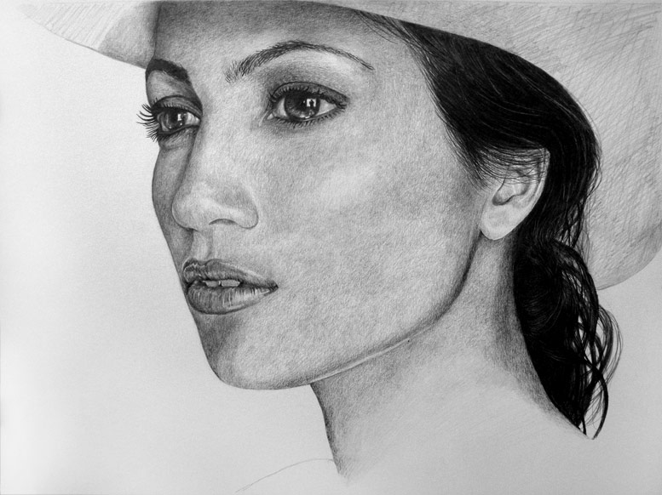
Is it a fact or an opinion?
1. Penguins are prettier than zebras.
2. The sun is yellow.
Opinion
Fact
3. People have two eyes and one nose.
Fact

Slide 10
Is it a fact or an opinion?
4. Everyone loves pizza.
5. I am the fastest runner in the world!
6. Tigers have black and orange fur.
7. Plants need sunshine and water to grow.
8. Lakewood is the best school.
Opinion
Opinion
Fact
Fact
Opinion

Slide 11
Turn to a partner and talk.
What is a fact?
What is an example of a fact?
What is an opinion?
What is an example of an opinion?

Slide 12
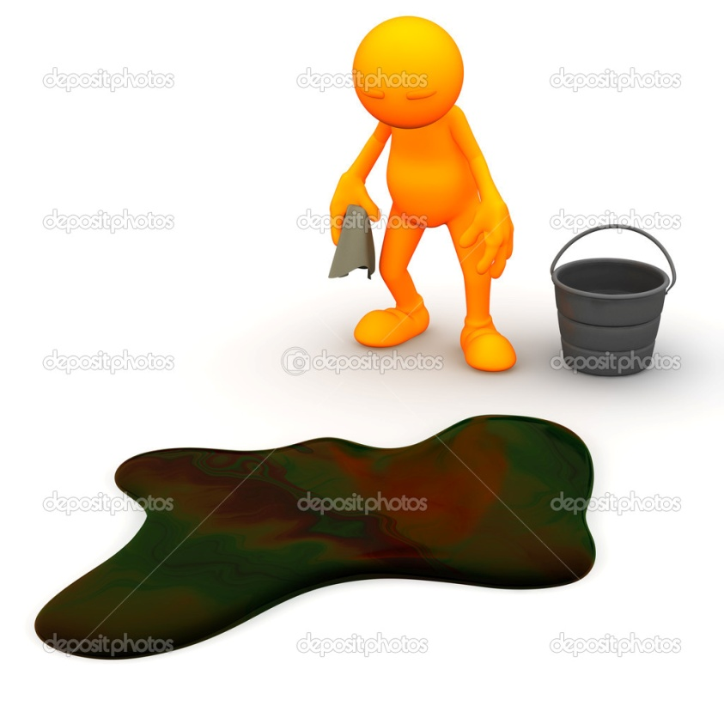
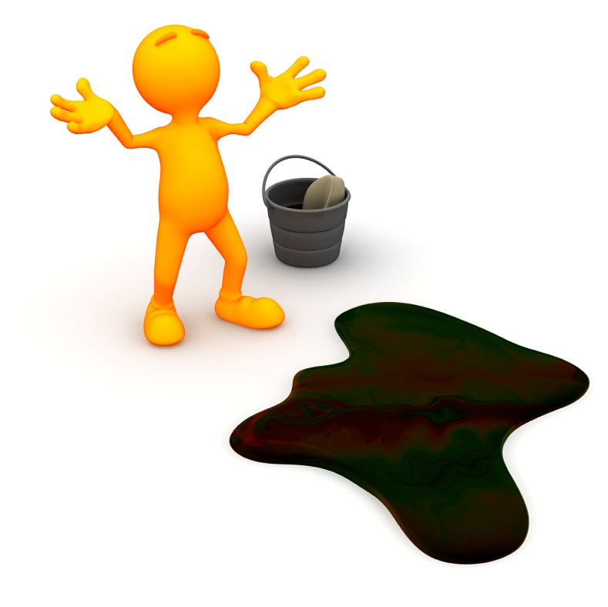
Problem Solution
Something that causes trouble.
How the problem is fixed or resolved.
Problem: You make a mess.
Solution: You clean up the mess.

Slide 13
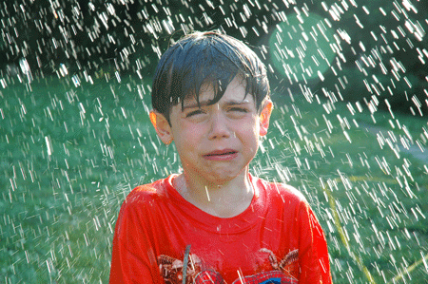
What is the problem? What is the solution?
Problem: The boy is getting wet.
Solution: The boy needs an umbrella.

Slide 14
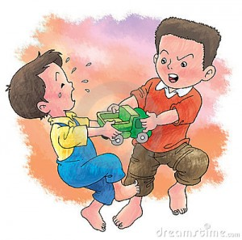
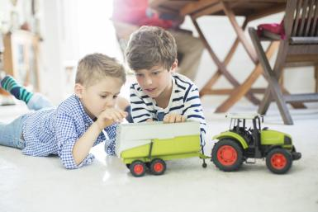
What is the problem? What is the solution?
Solution: The boys can play together and share the truck.
Problem: The boys both want to play with the truck.

Slide 15
What is the problem? What is the solution?
1. Ms. White sees Toby not doing his work. She tells him to move his clip.
What is Ms. White’s problem?
What is Ms. White’s solution?
Ms. White’s problem is Toby not doing his work.
Ms. White’s solution is to have Toby move his clip.

Slide 16
What is the problem? What is the solution?
2. Sofia wants chocolate ice cream. When she gets to the store there is no more chocolate ice cream.
What is Sofia’s problem?
How can Sofia do to solve her problem?
There is no more chocolate ice cream.
One solution is Sofia could get a different flavor of ice cream.

Slide 17
Turn to a partner and talk.
What is a problem?
What is a solution?
Why do we need solutions?

Slide 18
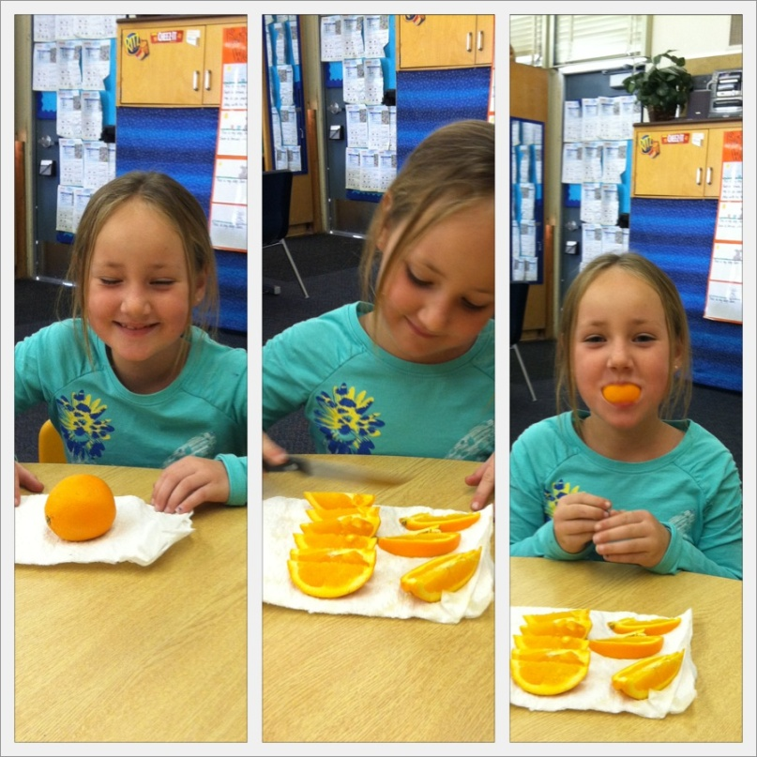
Sequence
Sequence is when you put events or steps in order.
You can use words like first, next, then, and finally.
First, the girl got an orange.
Finally, the girl ate her orange.
Then, the girl cut her orange into pieces.

Slide 19
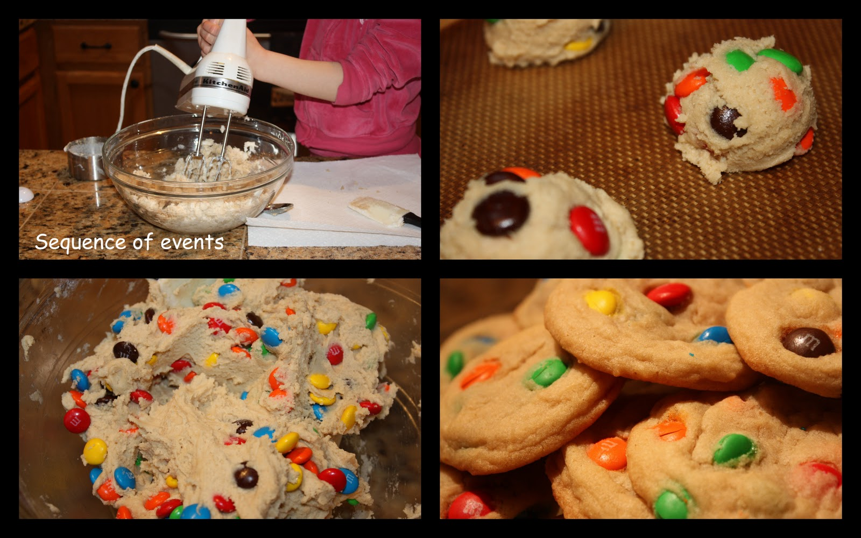
Sequence these pictures.
1
3
2
4

Slide 20
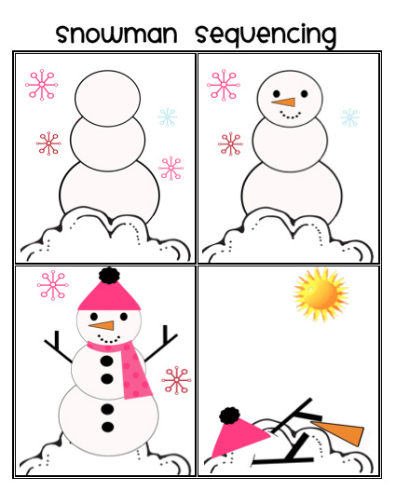
Which picture comes first?
Which picture comes next?
Which picture comes third?
Which picture comes last?
D
C
Picture D comes first.
Picture C comes next.
B
A
Picture B comes third.
Picture A comes last.

Slide 21
Sequence how to make cereal.
___. The boy uses his spoon to eat his cereal.
___. The boy pours milk into his cereal.
___. The boy gets out a bowl, a spoon, cereal, and milk.
___. The boy pours cereal into the bowl.
4
3
1
2

Slide 22
One day Ms. Blue asked Mark, “How do you get to school?”
Mark said, “First, I ride my bike to the bus stop. Then, I get on the bus. Next, I ride the bus to school. Finally, I get off the bus and go to the classroom.”
What does Mark do last?
Does Mark ride his bike or on the bus first?
Mark gets off the bus and goes to class last.
Mark rides his bike first.

Slide 23
Turn to your partner and talk.
What is sequence?
What words do we use when talking about sequence?
Why do people use sequence when telling a story or giving directions?

Slide 24
LEQ: How are details in an informational text related?
Sub LEQ 1: How are scientific details in a text connected?
(Cause and effect, fact and opinion, problem and solution)
Sub LEQ 2: How are steps in a technical text connected?
(Sequence)

