Slide 1
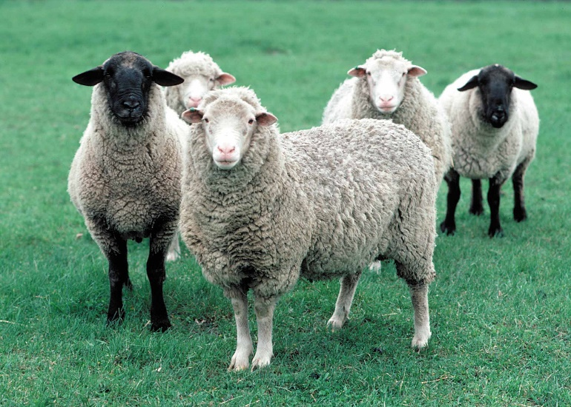
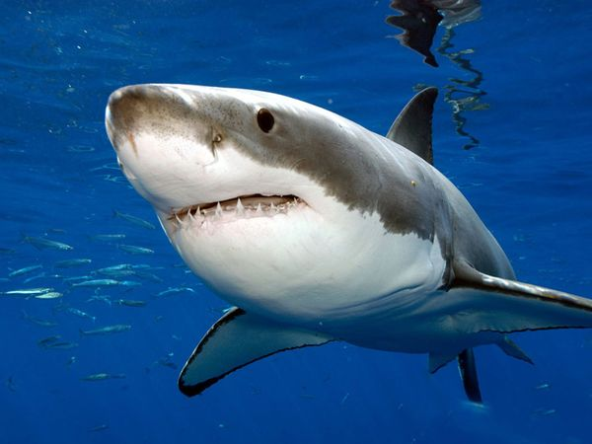
sh
sheep
shark
shovel

Slide 2
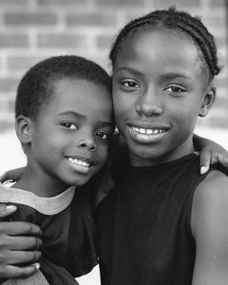
Sight Word Practice
one
I have one brother.

Slide 3
How do characters respond to major events and challenges?
Sub LEQ: What is a challenge?
A challenge is a problem the character must overcome (solve).

Slide 4
Challenge = something you must overcome or solve.
Example: The goldfish’s challenge is to jump from one fish bowl to the other.

Slide 5
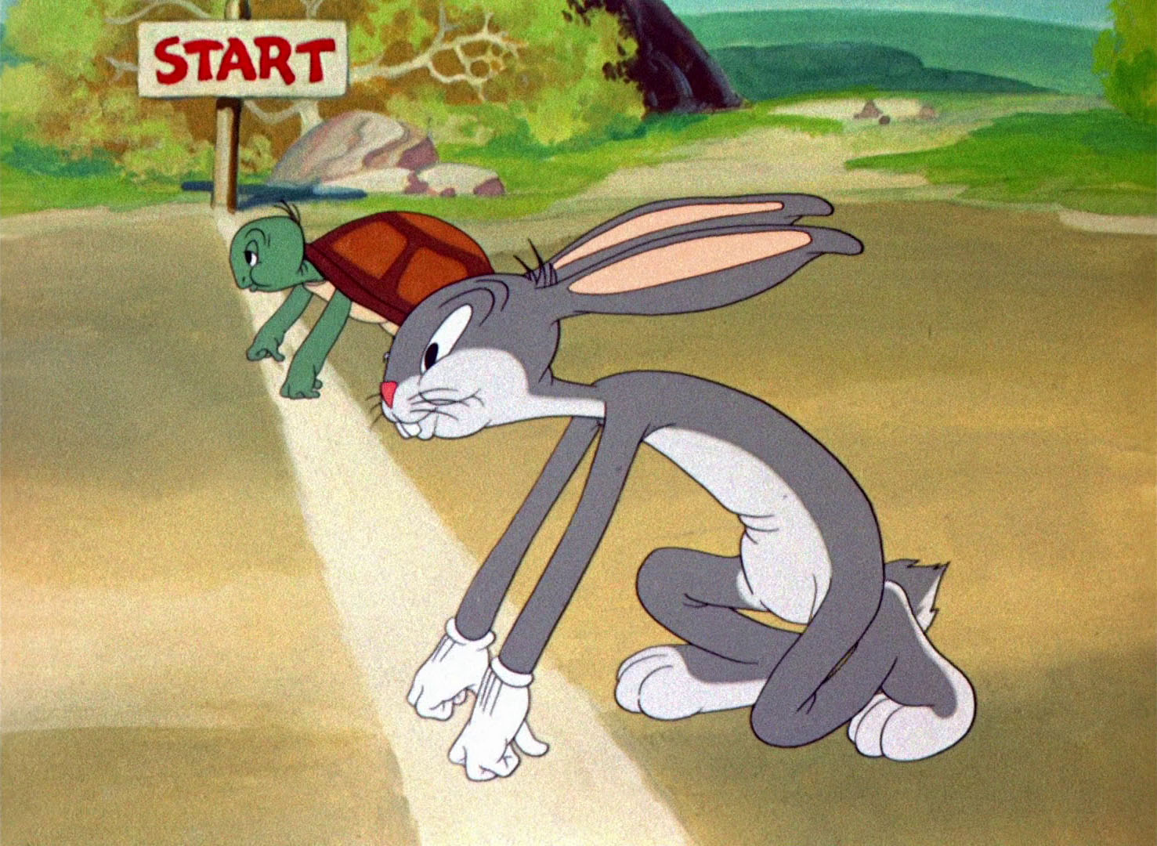
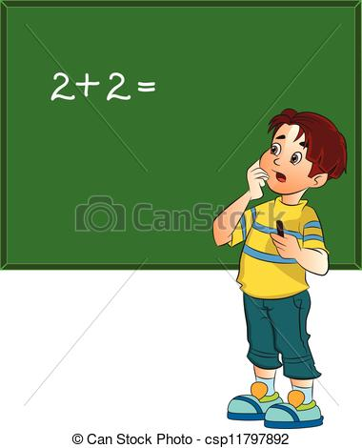
What is the challenge?
A boy is having trouble learning how to add.
What is the boy’s challenge?
The turtle and rabbit are going to race.
What is the turtle’s challenge?

Slide 6
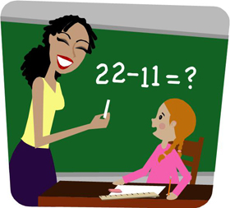
Can you think of a challenge you have in your life?
Example: My challenge is to become the best teacher I can be.

Slide 7
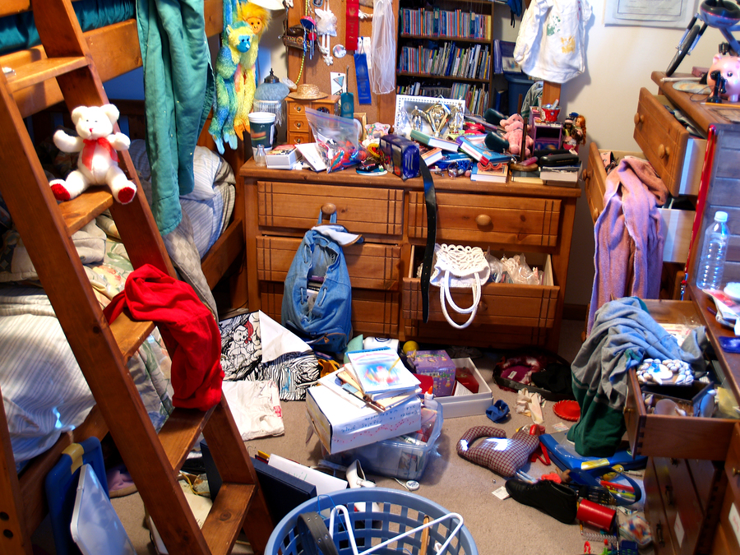
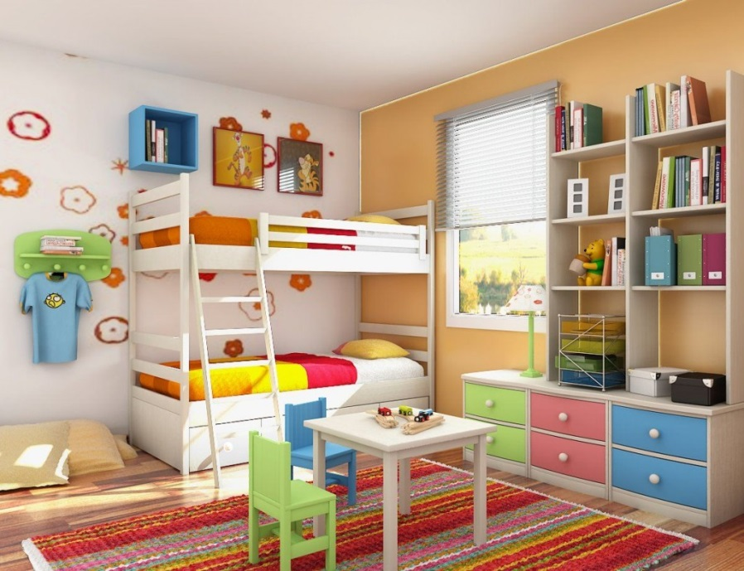
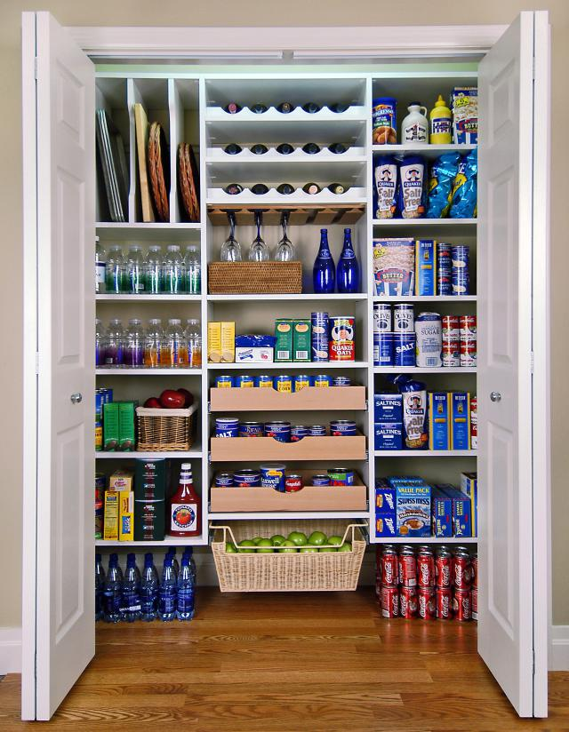
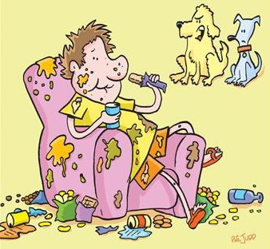
Brother Messy, Brother Neat Vocabulary
messy
neat
could
he
was
rules
promise
slob
organize

Slide 8
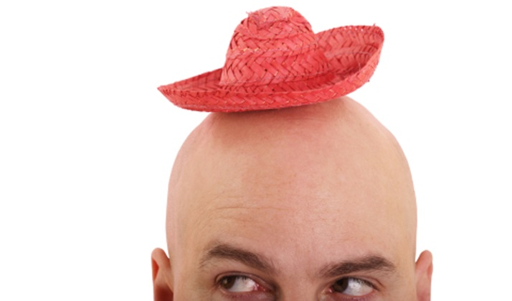
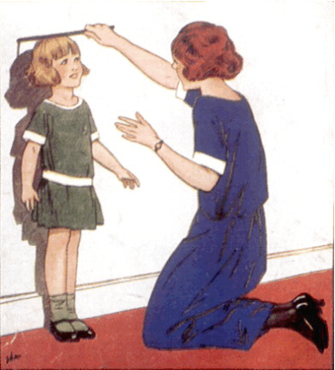
My Clothes Are Too Small Vocabulary
brother
my
old
too
small
summer
grown

Slide 9
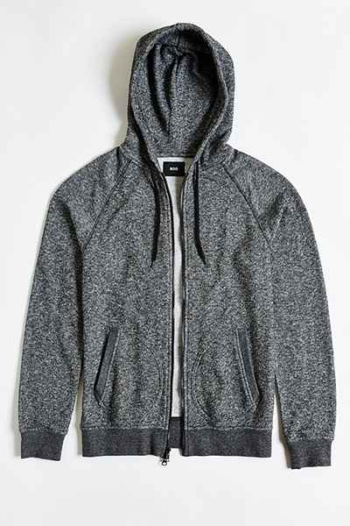
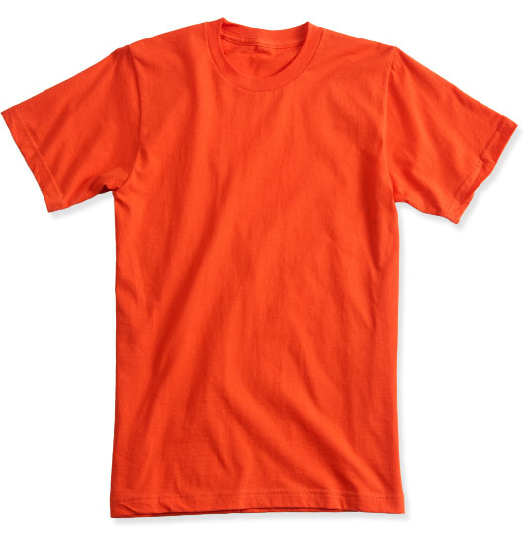
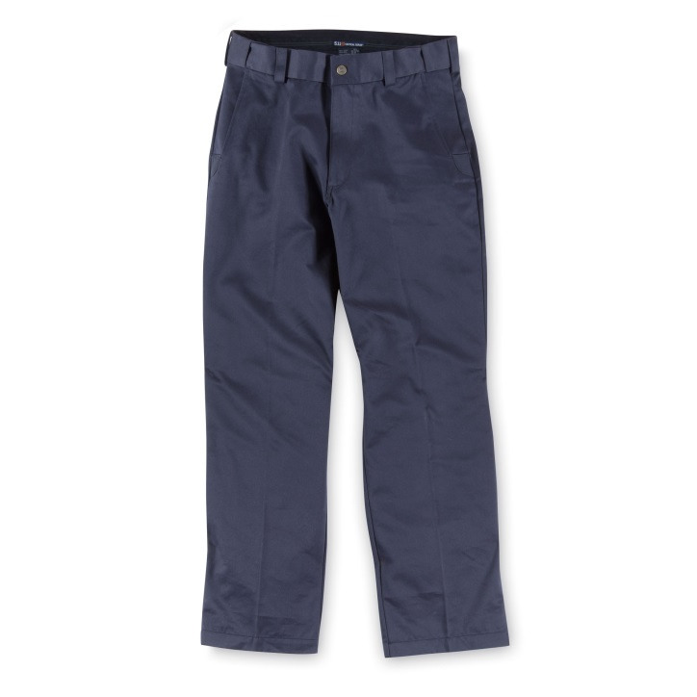
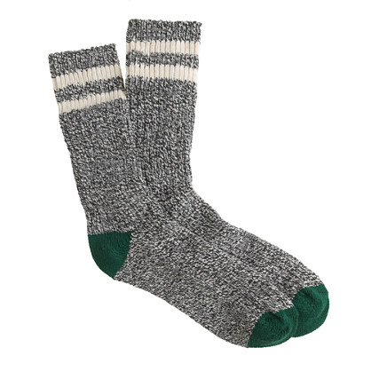
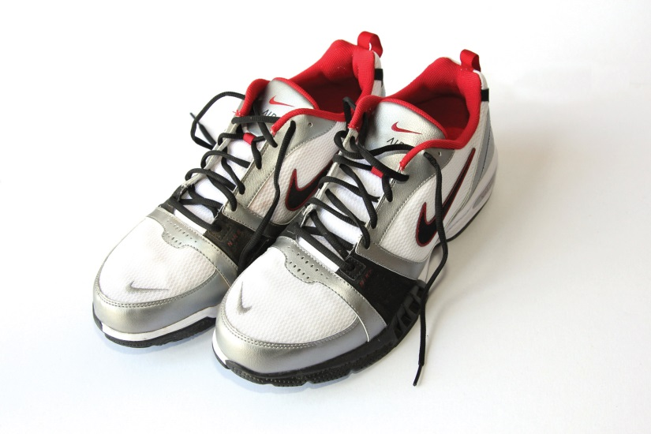
My Clothes Are Too Small Vocabulary
shirt
pants
sweatshirt
hat
socks
shoes

Slide 10
Mclass: How can you tell that the characters in the story are different. Use parts of the story in your answer.
The characters in the story are different because Nico is neat and Pablo is messy. I know this because the picture on page 3 shows Pablo’s room is messy and the picture on page 4 shows Nico’s room is neat. Another reason I know the brothers are different is when Nico calls Pablo a slob on page 6.

Slide 11
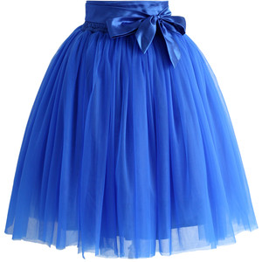
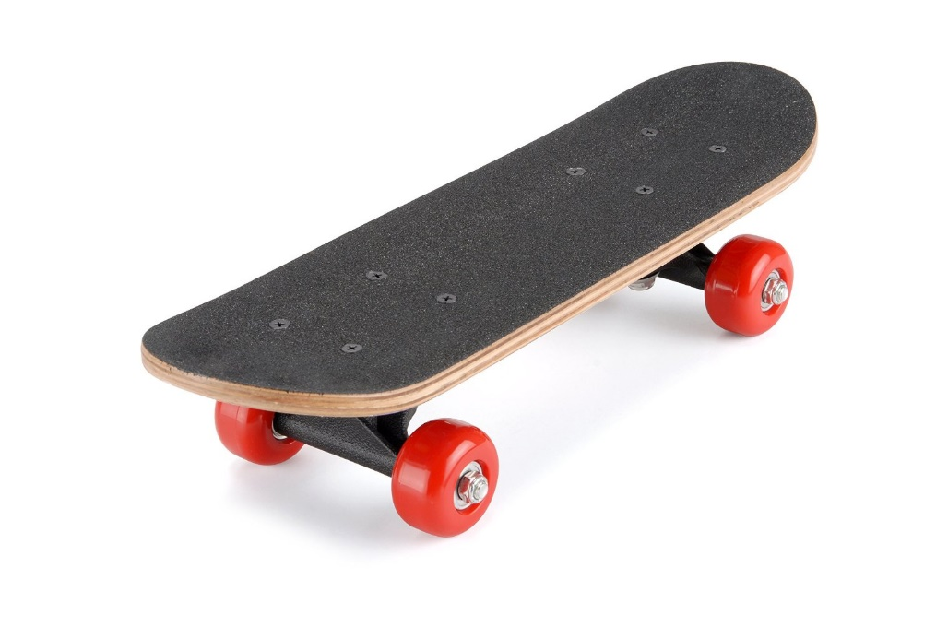
sk
skirt
skateboard
sky

Slide 12
Sight Word Practice
this
Is this a good apple?

Slide 13
How do characters respond to major events and challenges?
Sub LEQ: What is a response?
What a character does when something happens.

Slide 14
Challenge = something you must overcome or solve.
Example: The goldfish’s challenge is to jump from one fish bowl to the other.

Slide 15
Response = what a character does when something happens (like a challenge).
If the man’s challenge is he has no money. What can he do in response of this challenge?
Response to challenge
Challenge
He could get a job.
He could save his money.

Slide 16
How can I respond to this challenge?
Challenge: I am having trouble at school.
Ask the teacher for help.
Ask a friend for help.
Do your homework.
Ask your family for help.

Slide 17
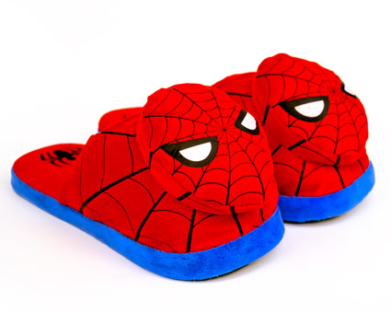
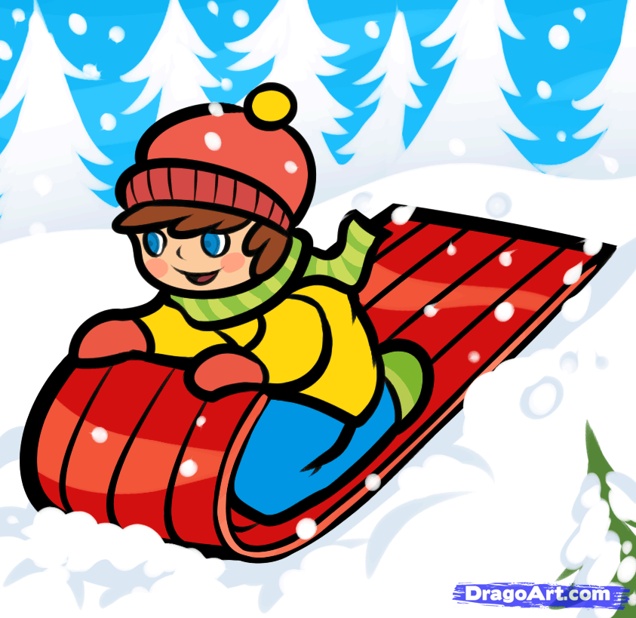
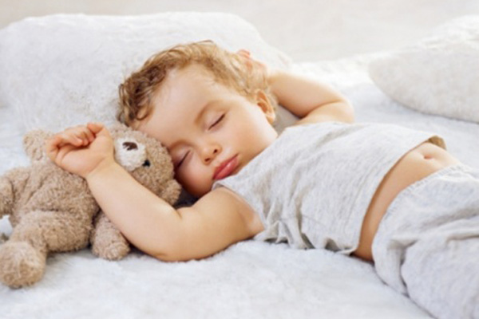
sl
slippers
sleep
sled

Slide 18
Sight Word
come
Please come in.

Slide 19
How do characters respond to major events and challenges?
Sub LEQ: How did the character respond to todays challenge?

Slide 20
Challenge = something you must overcome or solve.
Example: The goldfish’s challenge is to jump from one fish bowl to the other.

Slide 21
Response = what a character does when something happens (like a challenge).
If the man’s challenge is he has no money. What can he do in response of this challenge?
Response to challenge
Challenge
He could get a job.
He could save his money.

Slide 22
Now think about how the character responded to the challenge in your book.
Questions to think about:
What was the challenge?
What did the character do because of the challenge?
(The answer is the character’s response.)

Slide 23
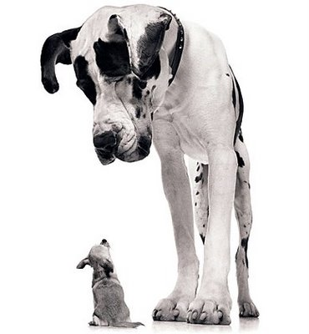
sm
smile
smart
small

Slide 24
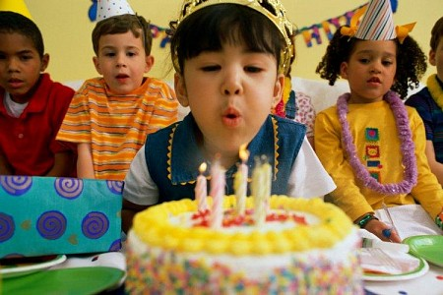
Sight Word
now
I am five years old now.

Slide 25
How do characters respond to major events and challenges?
Sub LEQ: How can a challenge change a character?
They learn a lesson.

Slide 26
Challenge = something you must overcome or solve.
Example: The goldfish’s challenge is to jump from one fish bowl to the other.

Slide 27
How does the man’s challenge change him?
Challenge
Response: He got a job.
The challenge changes the man because he now has money and a job where he can make more money.

Slide 28
How does the boy’s challenge change him?
Challenge: I am having trouble at school.
Response: Ask the teacher for help.
The challenge changes the boy because he is now smarter and knows what to do when he needs help.

