Slide 1
LEQ: How do I identify the main topic and retell key details of a text? RI K.2
Sub LEQ: How do I identify the main topic?

Slide 2
What is the main topic?
Family
Bed
?
School
Couch
Toys
Family
Home

Slide 3
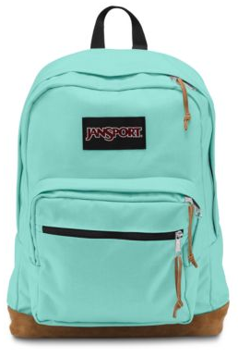
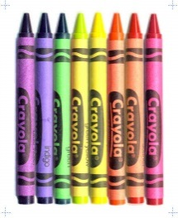
What is the main topic?
Family
Backpack
Pencil
?
Crayons
School
Glue
Scissors
Home
Paper

Slide 4
LEQ: How do I identify the main topic and retell key details of a text? RI K.2
Sub LEQ: How do I identify a key detail?

Slide 5
What key details do we need?
Bed
Crayons
Scissors
Home
Family
Couch
Backpack

Slide 6
What key details do we need?
Backpack
Couch
Scissors
School
Family
Bed
Crayons
Pencil

Slide 7
What key details do we need?
Grandfather and Grandmother
Couch
Family
Scissors
Mom and sister
Dad and brother
Crayons

