Slide 1
LEQ: What makes a story? K.RL.3
Sub LEQ: Who are the characters?

Slide 2
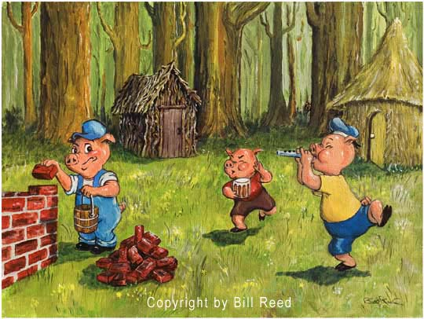
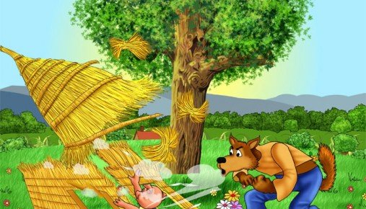
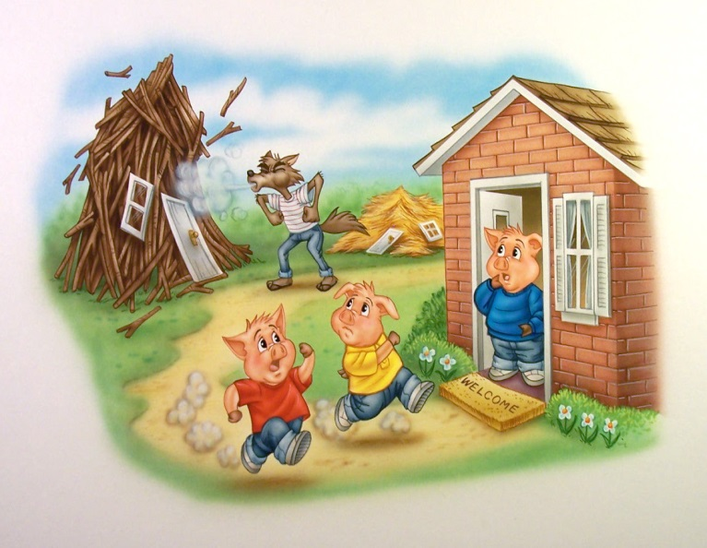
Pre-Test
The three little pigs built houses to live in.
A wolf came and blew the first pig’s house down.
Then the wolf blew down the second pig’s house. The pigs ran to the third pig’s house and were safe.
Pass out pictures to students.
Say: Point to the characters in the picture.
Mark who is correct.
Then pick up the pictures.

Slide 3
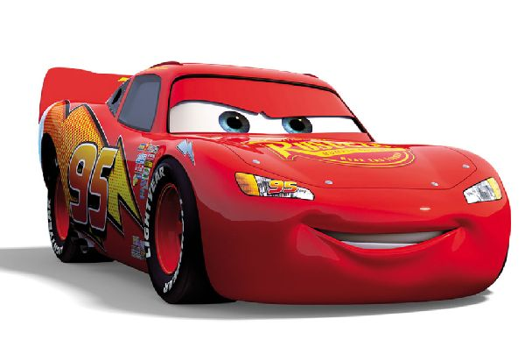
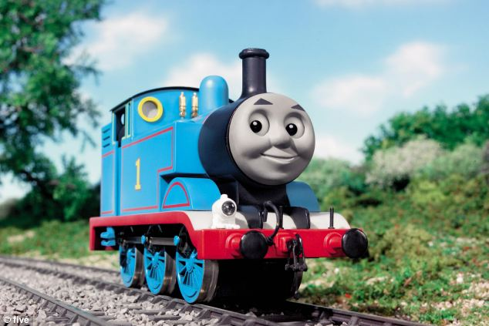
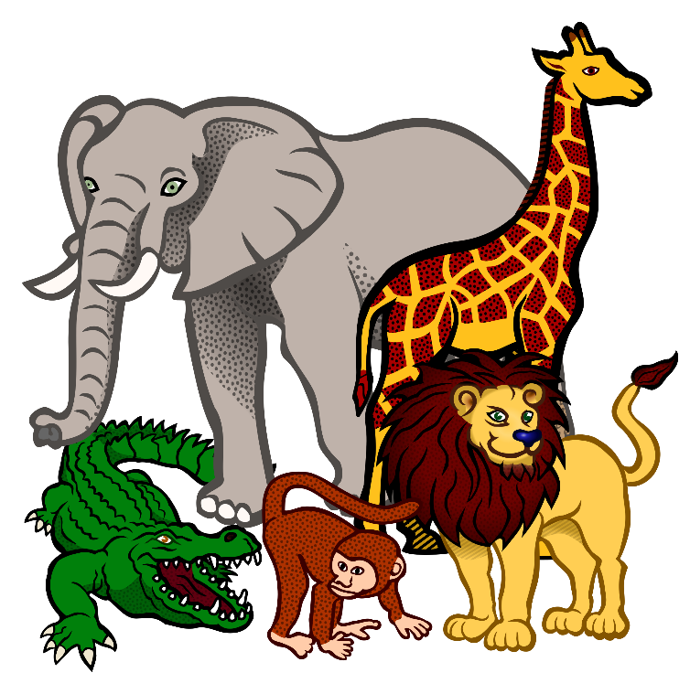
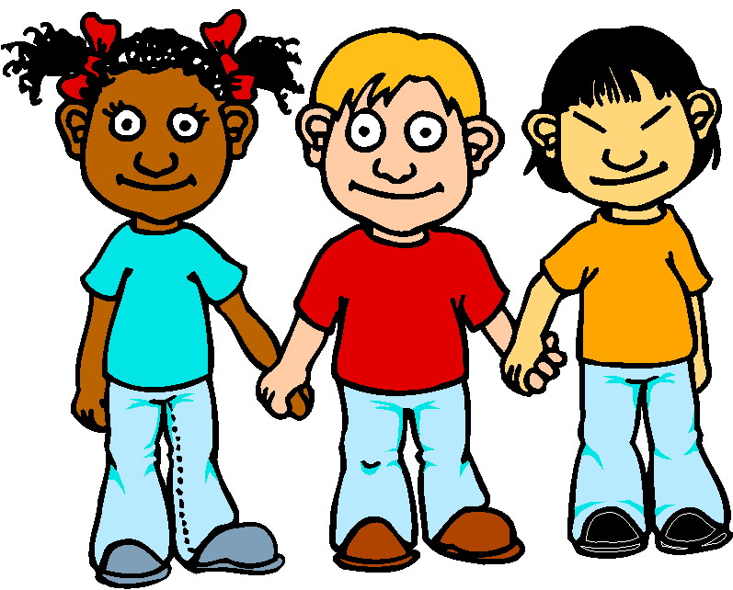
CHARACTERS
The characters are the people, animals, or things the story is about.

Slide 4
Carlos Goes to School

Slide 5
Post-Test
The three little pigs built houses to live in.
A wolf came and blew the first pig’s house down.
Then the wolf blew down the second pig’s house. The pigs ran to the third pig’s house and were safe.
Pass out pictures to students.
Say: Point to the characters in the picture.
Mark who is correct.
Then pick up the pictures.

Slide 6
LEQ: What makes a story? K.RL.3
Sub LEQ: What is the setting?

Slide 7
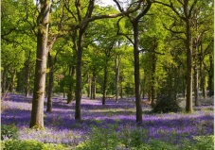
Pre-Test
The three little pigs built houses to live in.
A wolf came and blew the first pig’s house down.
Then the wolf blew down the second pig’s house. The pigs ran to the third pig’s house and were safe.
What is the setting?
1. Beach
2. Woods
3. City
Reread text
Review character
Read question
Students hold up finger amounts for answer.

Slide 8
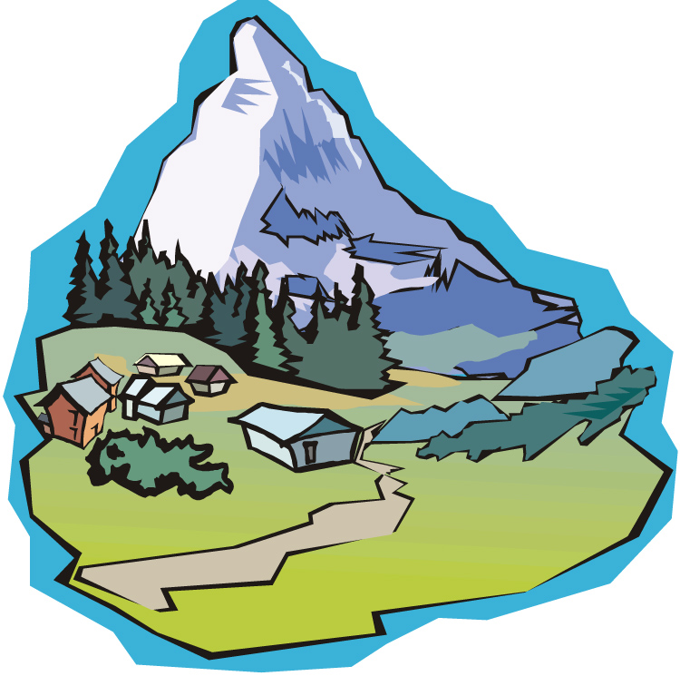
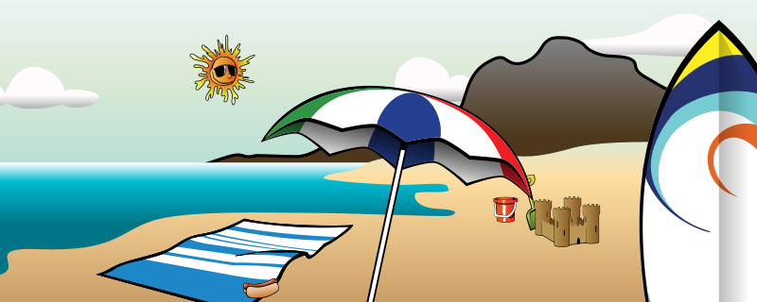
When = day or night
SETTING
The setting is where and when a story takes place.
Where = place

Slide 9
Carlos Goes to School

Slide 10
Post-Test
The three little pigs built houses to live in.
A wolf came and blew the first pig’s house down.
Then the wolf blew down the second pig’s house. The pigs ran to the third pig’s house and were safe.
What is the setting?
1. Beach
2. Woods
3. City
Reread text
Read question
Students hold up finger amounts for answer.

Slide 11
LEQ: What makes a story? K.RL.3
Sub LEQ: What happened in the beginning?

Slide 12
Pre-Test
Reread text
Review character and setting
Read question
Students hold up finger amounts for answer.
What happened in the beginning?
The three little pigs built houses to live in.
A wolf came and blew the first pig’s house down.
Then the wolf blew down the second pig’s house. The pigs ran to the third pig’s house and were safe.

Slide 13
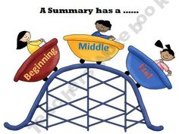
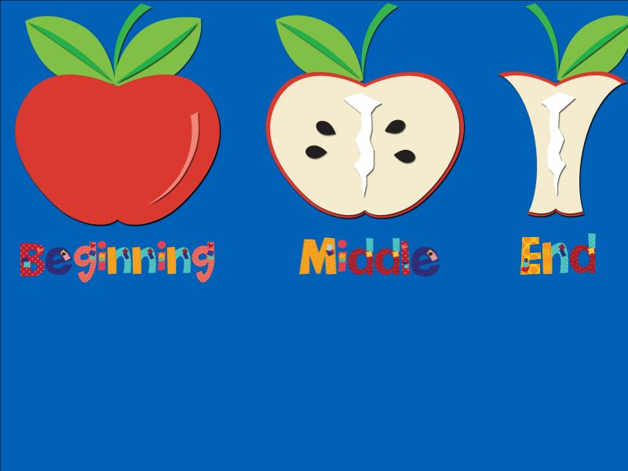
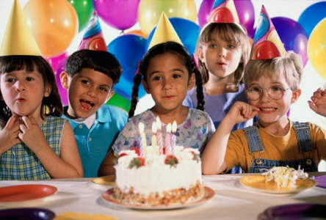
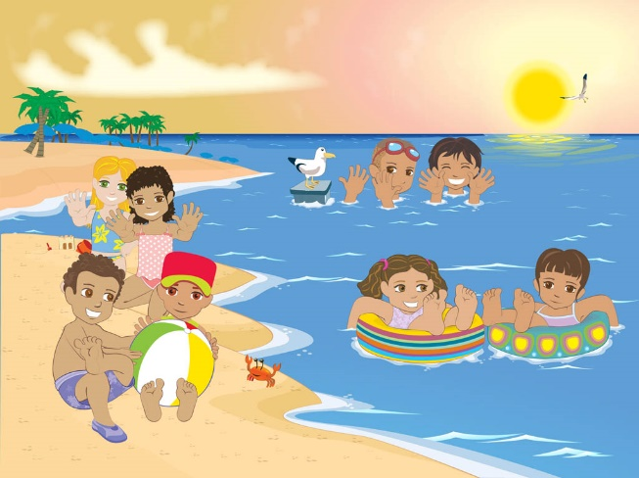
EVENTS
The events are what happen in the story. It includes the beginning, middle, and end.

Slide 14
Carlos Goes to School

Slide 15
Post-Test
Reread text
Review character and setting
Read question
Students hold up finger amounts for answer.
What happened in the beginning?
The three little pigs built houses to live in.
A wolf came and blew the first pig’s house down.
Then the wolf blew down the second pig’s house. The pigs ran to the third pig’s house and were safe.

Slide 16
LEQ: What makes a story? K.RL.3
Sub LEQ: What happened in the middle?

Slide 17
Pre-Test
Reread text
Review character and setting
Read question
Students hold up finger amounts for answer.
What happened in the middle?
The three little pigs built houses to live in.
A wolf came and blew the first pig’s house down.
Then the wolf blew down the second pig’s house. The pigs ran to the third pig’s house and were safe.

Slide 18
EVENTS
The events are what happen in the story. It includes the beginning, middle, and end.

Slide 19
Carlos Goes to School

Slide 20
Post-Test
Reread text
Review character and setting
Read question
Students hold up finger amounts for answer.
What happened in the middle?
The three little pigs built houses to live in.
A wolf came and blew the first pig’s house down.
Then the wolf blew down the second pig’s house. The pigs ran to the third pig’s house and were safe.

Slide 21
LEQ: What makes a story? K.RL.3
Sub LEQ: What happened at the end?

Slide 22
Pre-Test
Reread text
Review character and setting
Read question
Students hold up finger amounts for answer.
What happened at the end?
The three little pigs built houses to live in.
A wolf came and blew the first pig’s house down.
Then the wolf blew down the second pig’s house. The pigs ran to the third pig’s house and were safe.

Slide 23
EVENTS
The events are what happen in the story. It includes the beginning, middle, and end.

Slide 24
Carlos Goes to School

Slide 25
Post-Test
Reread text
Review character and setting
Read question
Students hold up finger amounts for answer.
What happened at the end?
The three little pigs built houses to live in.
A wolf came and blew the first pig’s house down.
Then the wolf blew down the second pig’s house. The pigs ran to the third pig’s house and were safe.

Slide 26
LEQ: What makes a story? K.RL.3

Slide 27
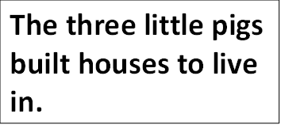
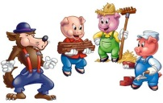
LEQ: What makes a story?
illustrations
words
Story Elements
Draw an ‘a’ next to the ones we need and a ‘c’ next to the ones we don’t need.
Model.

