Slide 1
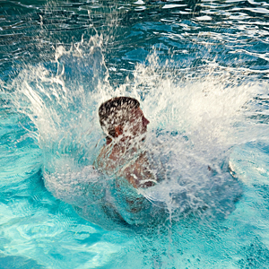
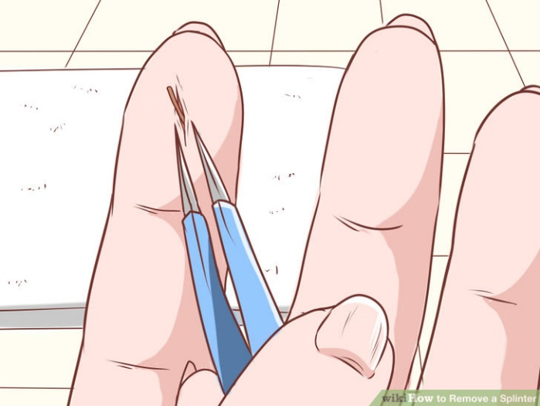
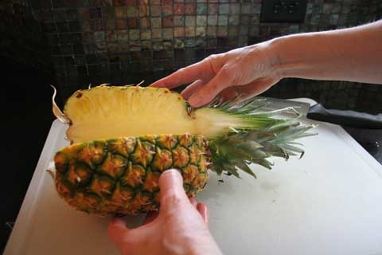
splash
splinter
spl
split

Slide 2
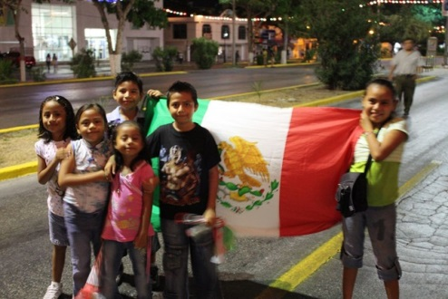
Sight Word
from
We are from Mexico.

Slide 3
How do I determine the main idea of a multiparagraph text?
Sub LEQ: How can I determine the main topic of a single paragraph?
Pull out the details and determine what they are all about.

Slide 4
Main Topic

Slide 5
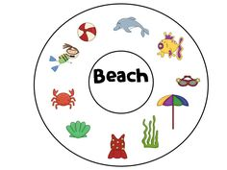
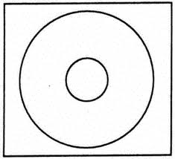
What is the main topic?
Example:
Fruit
The main topic is the beach.
The pictures are the details.

Slide 6
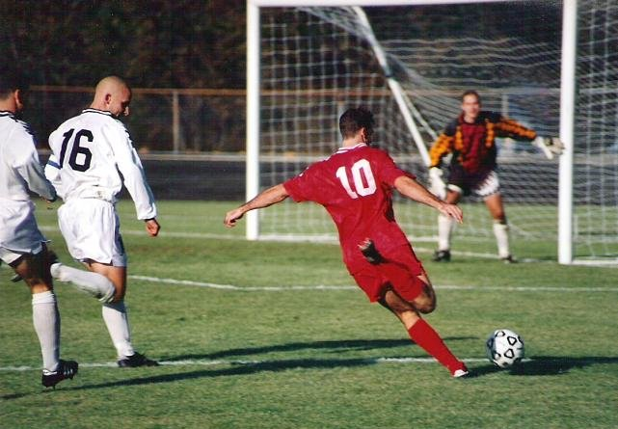
What is the main topic, main idea, and details?
These are facts about soccer.
Soccer is a sport.
To play soccer I need a soccer ball.
I can make a goal by putting the soccer ball in the net.
_______________ ← Main Idea
______________ ← Detail
___________________________ ← Detail
____________________________________________ ← Detail
The main Topic is soccer.

Slide 7
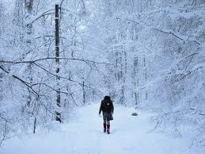
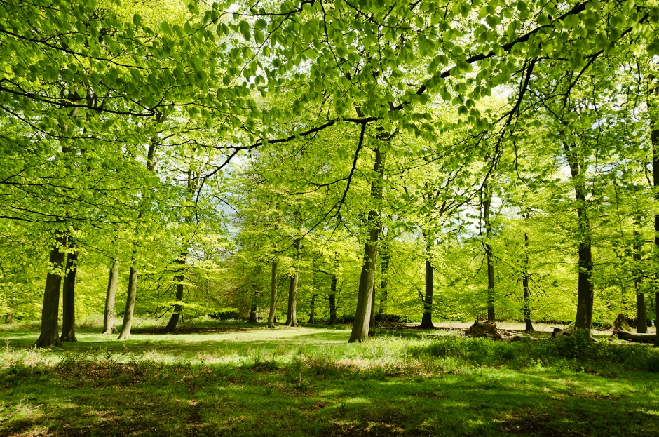
The Four Seasons Vocabulary
seasons
spring
fall
winter
summer

Slide 8
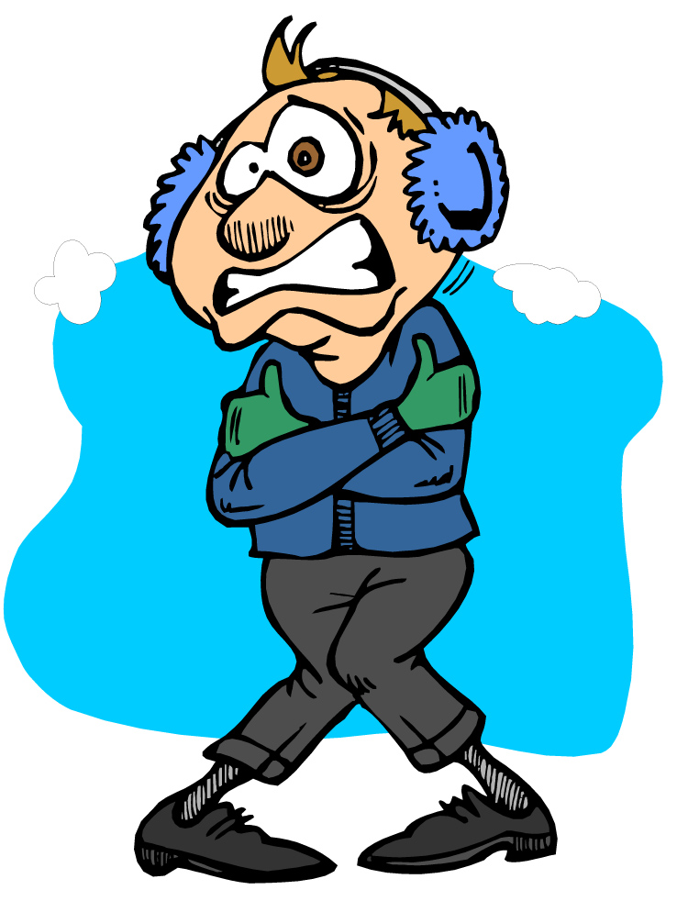
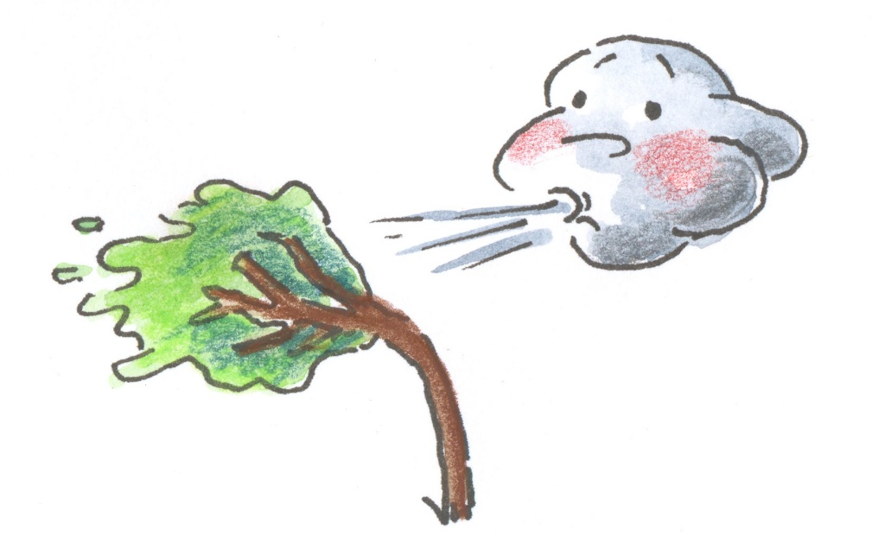
The Four Seasons Vocabulary
colder
shorter
snow
longer
come
winds

Slide 9
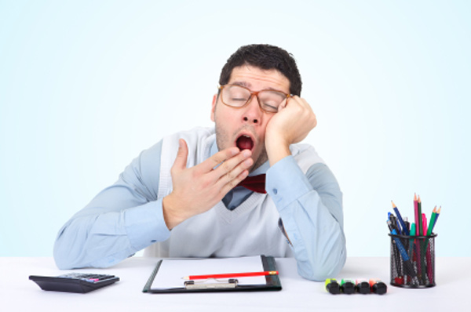
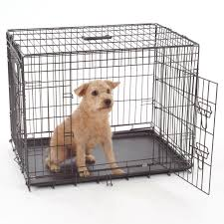
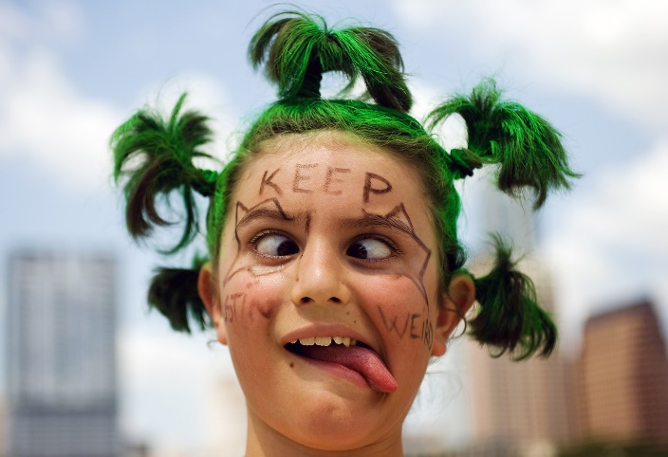
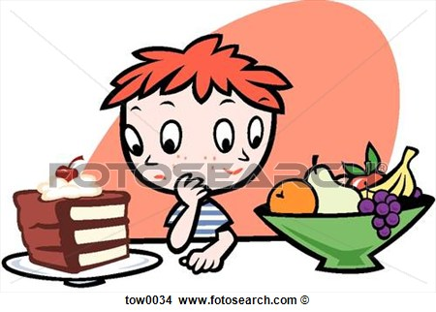
What Pet Should I Get? Vocabulary
pro
con
boring
opinions
playmate
research
cage
decide
weird

Slide 10
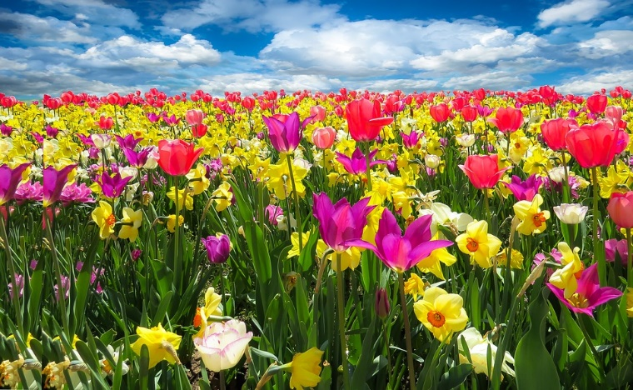
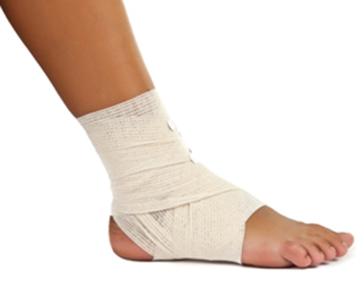
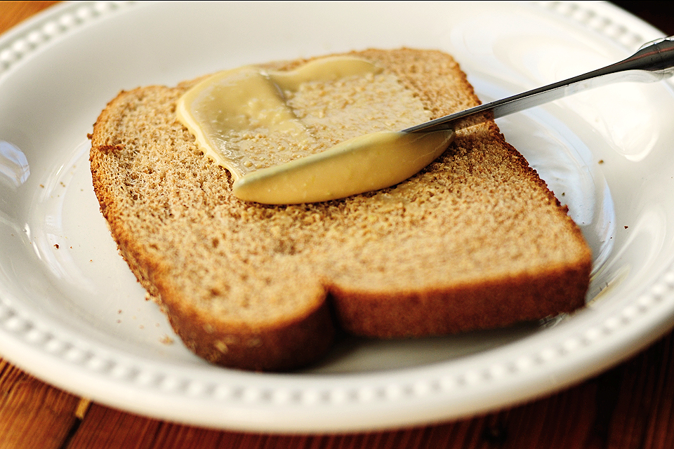
spring
sprain
spr
spread

Slide 11
Sight Word
good
We are good friends.

Slide 12
How do I determine the main idea of a multiparagraph text?
Sub LEQ: How can I determine the main topic of a multiparagraph text?
Pull all of the paragraphs main topic together and see how they relate.

Slide 13
What is the main topic of each paragraph?
Where Animals Live
P1 The sky is full of animals. Animals with wings can fly in the sky. Birds are the most common flying animals, but bats and other animals also spend time in flying up high.
The main topic is flying animals.
P2 In the water I can see many different animals. Fish are one animal that can only live in water. Sharks, dolphins, and sting rays also live in the water.
The main topic is water animals.
P3 Big animals, like elephants and rhinos, roam the land. Small animals, like rabbits and lizards, live on land too. Many different kinds of animals make the land their home.
The main topic is land animals.

Slide 14
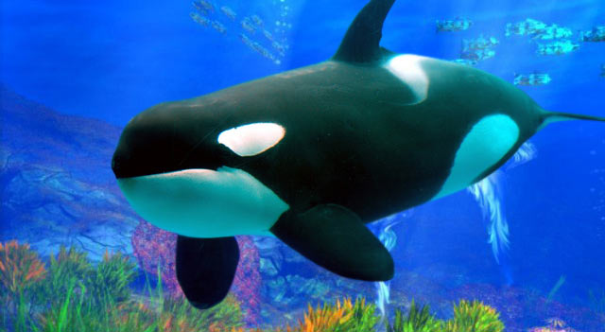
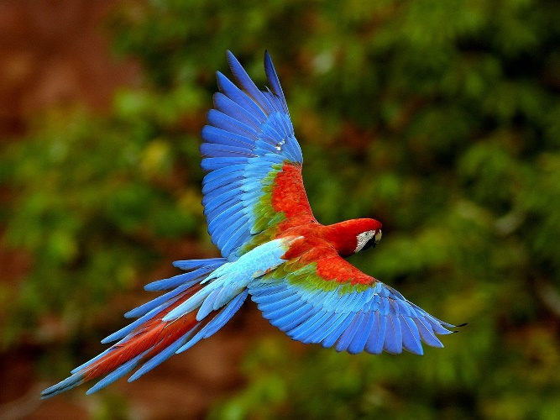
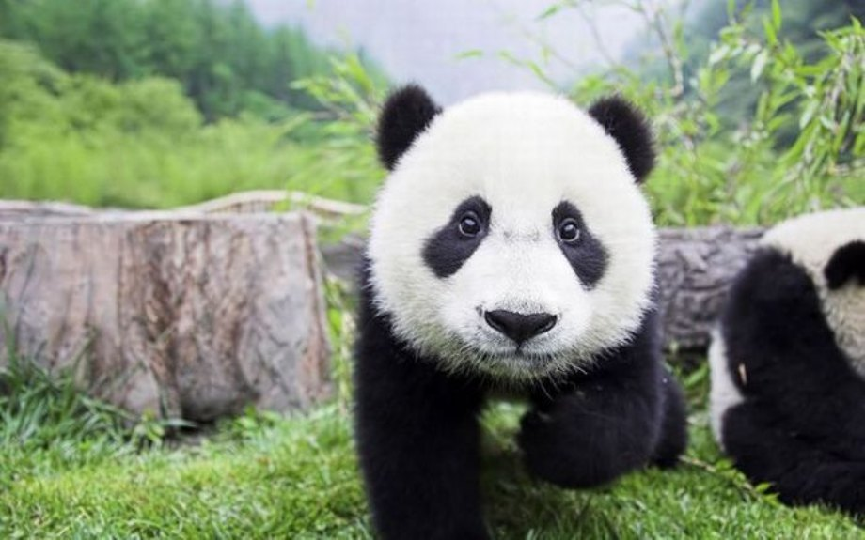
What is the main topic of the whole text?
Paragraph 1- The main topic is flying animals.
Paragraph 2- The main topic is water animals.
Paragraph 3- The main topic is land animals.
What is the main topic of the text?
The main topic of the text is animals.
How do you know?
Each paragraph talks about where different animals live.

Slide 15
Synonyms and Describing Words
Synonyms are words that mean the same thing.
Example: pretty and beautiful, happy and glad, mad and angry.
Describing words are words that give you details about something.
Example: The green lizard. I need three potatoes.
The smelly shoe. The cute panda. The sweet chocolate.

Slide 16
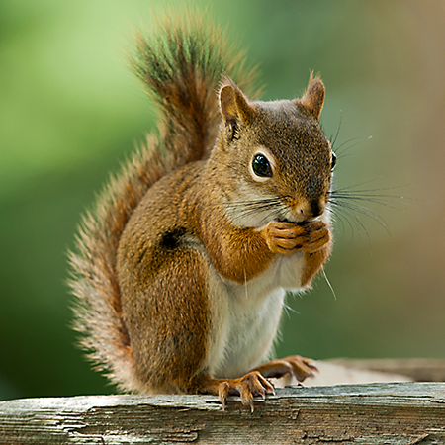
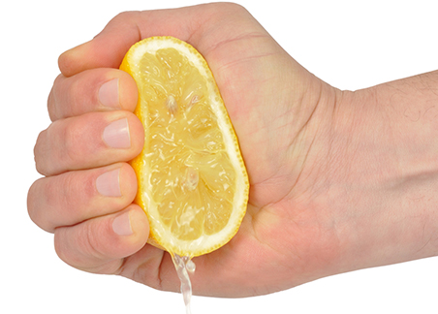
squ
square
squirrel
squeeze

Slide 17
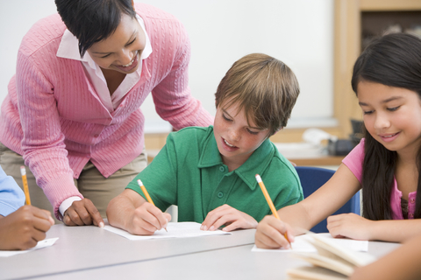
Sight Word
any
Do you need any help?

Slide 18
How do I determine the main idea of a multiparagraph text?
Sub LEQ: Why is determining the main topic of a story useful?
Allows the reader to make connections to the story and understand the information.

Slide 19
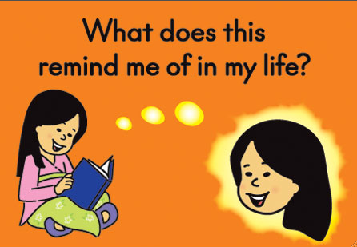
Why do I need to know the main topic or main idea of a text?
Allows the reader to
make connections to the story and understand the information.

Slide 20
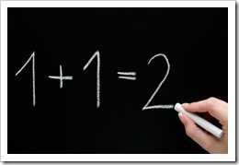
Facts and Opinions
Facts are true statements.
Example: Grass is green. Ms. Keating is a teacher. Pencils are used at school.
Opinions are statements about what people think or feel.
Example: Orange is the best color and fruit. Ms. Keating would be the best president ever. The sky is purple.

Slide 21
How do I determine the main idea of a multiparagraph text?

Slide 22
Main Idea

