Slide 1
LEQ: How do I identify the main topic and retell key details of a text?
12/3

Slide 2
What is the main topic? The main topic is what the book is mostly about.

Slide 3
LEQ: How do I identify the main topic and retell key details of a text?
12/4
Sub LEQ: How do I use words and pictures to identify the main topic?

Slide 4
How do I identify the main topic?
Words
Pictures

Slide 5
What is the main topic?

Slide 6
LEQ: How do I identify the main topic and retell key details of a text?
12/5
Sub LEQ: How do I identify the main topic?

Slide 7
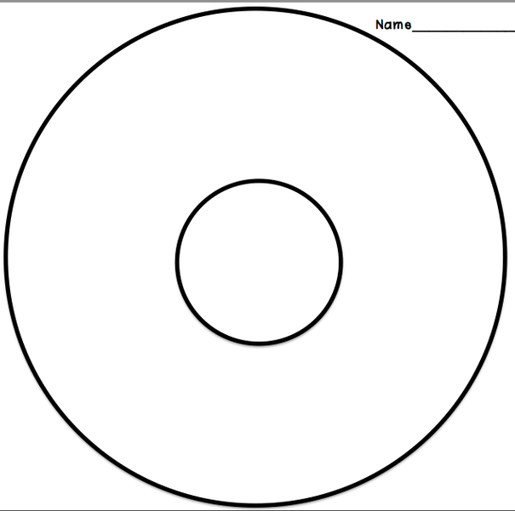
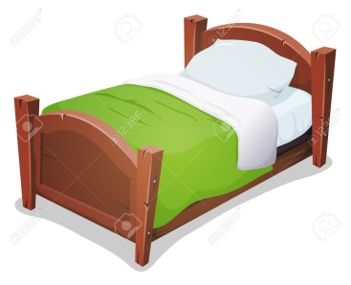
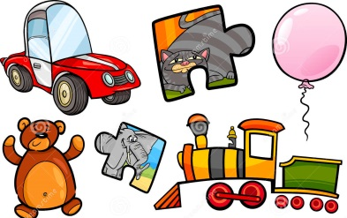
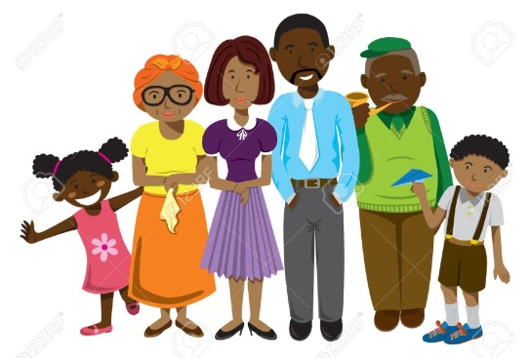
What is the main topic?
Family
Bed
?
School
Couch
Toys
Family
Home

Slide 8
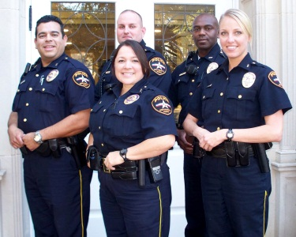
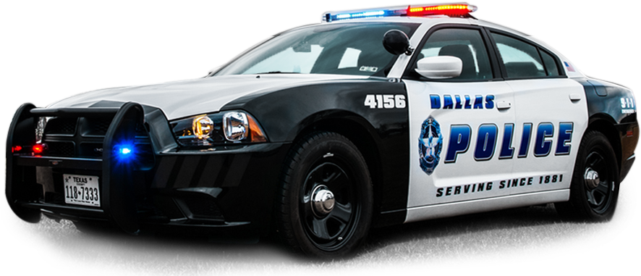
Read to find the main topic.
The police drive police cars.
Police officers help protect us.

Slide 9
LEQ: How do I identify the main topic and retell key details of a text?
12/6
Sub LEQ: How do I identify a key detail?

Slide 10
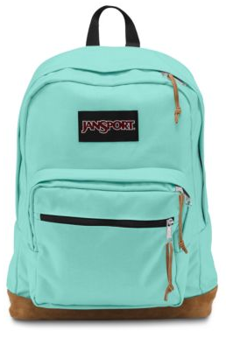
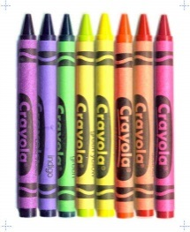
What key details tell you about the main topic?
Backpack
Couch
Scissors
School
Family
Bed
Crayons
Pencil

Slide 11
Find a key detail. What tells you about the main topic?
The police drive police cars.
Police officers help protect us.

Slide 12
LEQ: How do I identify the main topic and retell key details of a text?
12/9
Sub LEQ: What does it mean to retell?

Slide 13
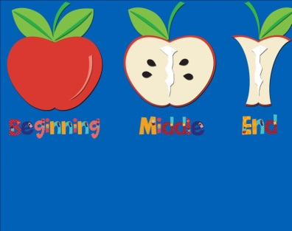
Retell means to talk about the book
1
2
3
1
2
3

Slide 14
Retell.
1
2
3

Slide 15
LEQ: How do I identify the main topic and retell key details of a text?
12/10
Sub LEQ: How do I retell the first key detail?

Slide 16
Retell means to talk about the book
1
2
3
1
2
3

Slide 17
Which one came first?
1
2
3

Slide 18
LEQ: How do I identify the main topic and retell key details of a text?
12/11
Sub LEQ: How do I retell the second key detail?

Slide 19
Retell means to talk about the book
1
2
3
1
2
3

Slide 20
Which came second?
1
2
3

Slide 21
LEQ: How do I identify the main topic and retell key details of a text?
12/11
Sub LEQ: How do I retell the third key detail?

Slide 22
Retell means to talk about the book
1
2
3
1
2
3

Slide 23
Which came third?
1
2
3

Slide 24
LEQ: How do I identify the main topic and retell key details of a text?
12/12

Slide 25
How do I identify the main topic and key details?
Words
Pictures

