Slide 1
LEQ: How do I ask and answer questions about key details in a text? RL K.1
Sub LEQ: What do readers do to understand a text?

Slide 2
Questions Preguntas | Answers Repuestas

Slide 3
How can I understand a text? I can ask and answer questions!
Questions? Preguntas? | Answers. Respuestas.
How are you? Como estas? | I am good. Estoy bien.
How old are you? Cuantos años tienes? | I am five years old. Tengo cinco años.

Slide 4
LEQ: How do I ask and answer questions about key details in a text? RL K.1
Sub LEQ: Why do I ask a question?

Slide 5
Questions Preguntas | Answers Repuestas

Slide 6
Questions help me understand. (Preguntas)
What is your name?
My name is Esther.
Do you need a pencil?
Yes, please.
Where are you?
In my classroom.

Slide 7
LEQ: How do I ask and answer questions about key details in a text? RL K.1
Sub LEQ: What is an answer?

Slide 8
Questions Preguntas | Answers Repuestas

Slide 9
Answers are my response to the question. (Repuestas)
What is your name?
My name is Esther.
Do you need a pencil?
Yes, please.
Where are you?
In my classroom.

Slide 10
LEQ: How do I ask and answer questions about key details in a text? RL K.1
Sub LEQ: How do I ask questions about key details?

Slide 11
Questions Preguntas | Answers Repuestas

Slide 12
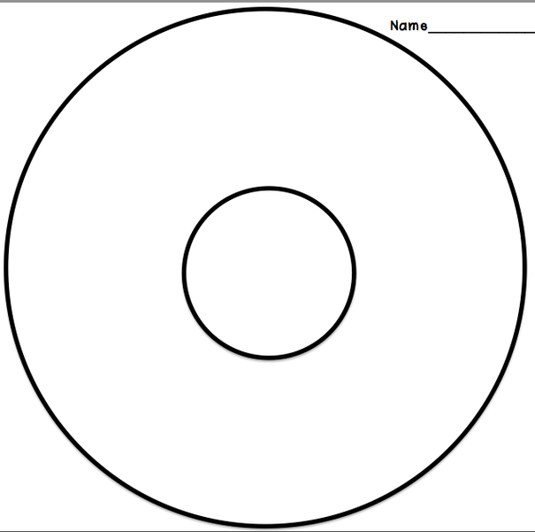
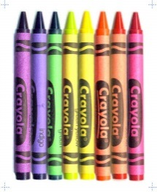
What key details do we need?
Grandfather and Grandmother
Couch
Family
Scissors
Mom and sister
Dad and brother
Crayons

