Slide 1
LEQ: How do I retell familiar stories? RL K. 2
Sub LEQ: What are key details?

Slide 2
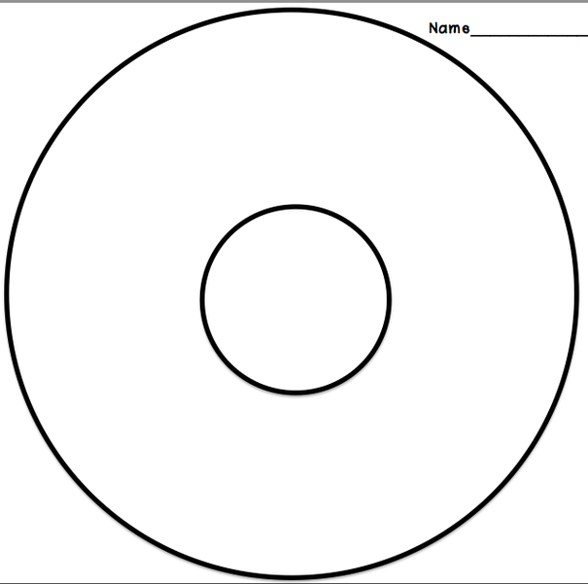
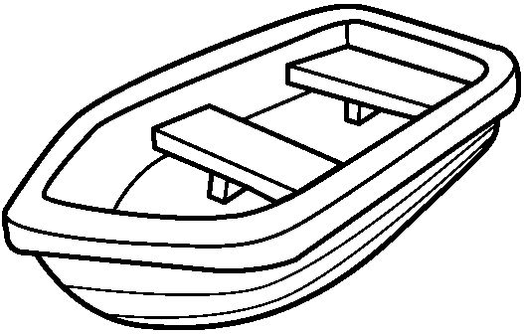
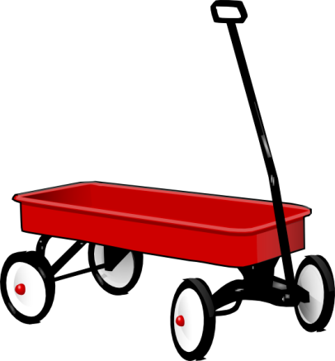
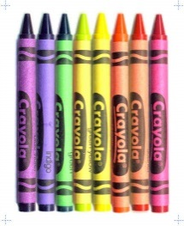
What key details describe the story In?
Grandfather and Grandmother
Boat
In
Scissors
car
wagon
Crayons

Slide 3
LEQ: How do I retell familiar stories? RL K. 2
Sub LEQ: What does it mean to retell a story?

Slide 4
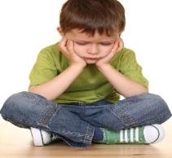
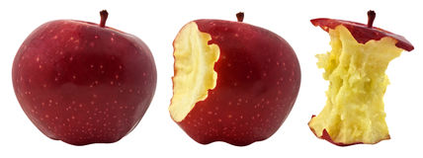
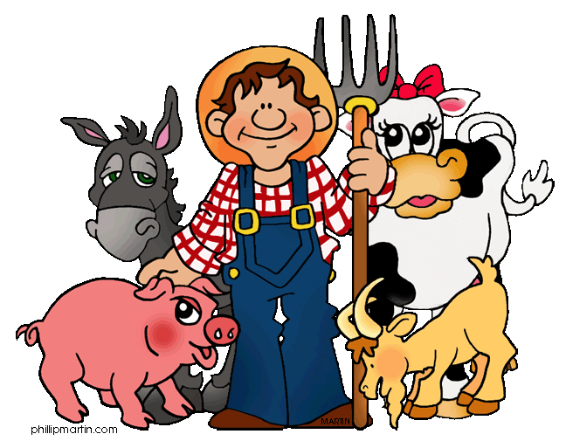
Retell- Tell the story in your own words.
Problem
Setting
Events- BME
Solution
Characters
5 Finger Fiction Retell

Slide 5
LEQ: How do I retell familiar stories? RL K. 2
Sub LEQ: How do I retell major events in a story?

Slide 6
Tell the beginning, middle, and end
1
2
3
1
2
3

Slide 7
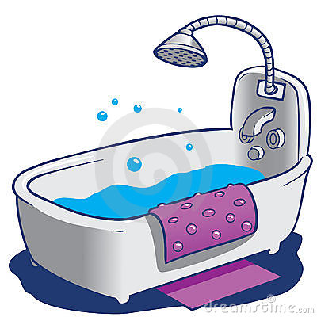
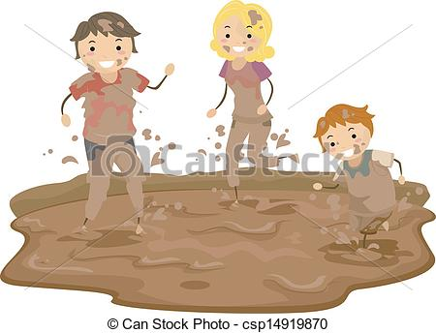
Beginning, Middle, End
1
2
3

Slide 8
LEQ: How do I retell familiar stories? RL K. 2
Sub LEQ: How do I retell the beginning of the story?

Slide 9
Where is the beginning?
1
2
3
1
2
3

Slide 10
What happens at the beginning?
1
2
3

Slide 11
LEQ: How do I retell familiar stories? RL K. 2
Sub LEQ: How do I retell the middle of the story?

Slide 12
Where is the middle?
1
2
3
1
2
3

Slide 13
What happens in the middle?
1
2
3

Slide 14
LEQ: How do I retell familiar stories? RL K. 2
Sub LEQ: How do I retell the end of the story?

Slide 15
Where is the end?
1
2
3
1
2
3

Slide 16
What happens at the end?
1
2
3

Slide 17
LEQ: How do I retell familiar stories? RL K. 2
Sub LEQ: How do I retell a familiar story?

Slide 18
Retell- Tell the story in your own words.
Problem
Setting
Events- BME
Solution
Characters
5 Finger Fiction Retell

Slide 19
What happens in this story?
1
2
3
The monkey got in the car.
The monkey got in the mud.
The monkey got in the bathtub.

Slide 20
LEQ: How do I retell familiar stories? RL K. 2

Slide 21
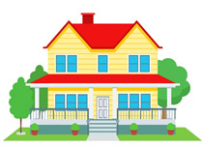
To retell stories I use my words and key details.
Grandfather and Grandmother
Boat
House
Scissors
Out
car
wagon
Crayons

